Slide 1
Lights out for SDH
INNOVATION YOU NEED
TECHNOLOGY YOU TRUST
PEOPLE YOU DEPEND ON
What you need to know but were afraid to ask
David Stokes, Elea Siegele and Tony Thorley

Slide 2
What SDH Taught Us That We Still Need Today
Tony

Slide 3
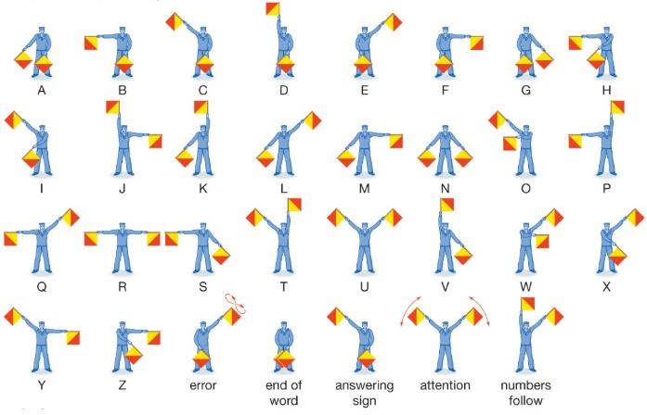
A Brief History of Time SDH
Pre SDH telecom transport
Little service visibility
No integrated resilience
Non-standard; multiplexing / interfaces speeds
No interworking between different systems
What SDH (1990ish) did for us
Comprehensive service monitoring
Service protection and network resilience
Managed and resilient timing distribution
Interworking
Next generation SDH (2006ish)
GFP, VCAT, LCAS: mapping of data into adjustable variable sized containers
Notes:
Pre SDH
Little service visibility, no integrated resilience in transport, non-standard multiplexing, non-standard interfaces, no standard way to multiplex to higher speeds. No interworking between different vendors systems
Post SDH (1990)
Overheads added for service monitoring, service protection (hop by hop and end to end), resilient network management paths comprehensive timing distribution
Next gen SDH
GFP, VCAT, LCAS: mapping of data into variable sized containers adjustable in service

Slide 4
What SDH Users Want?
Hard service separation
Hard performance guarantees, accurate timing and excellent OAM
Easy to design, deploy and manage
E1s and T1s are still widely used for voice services and Sub E1/T1 services continue to be used in large quantities by operators of power, rail, pipeline etc. networks
SDH is well understood by generations of network planners, designers, users and customers – who are reluctant to change

Slide 5
What Could Possibly Go Wrong?
Do you know what is out there?
Where it is?
How it is connected?
What services are live?
What services are live and being used?
What services are being paid for (live and not live)?
SDH carries internal services such as timing, network management for other networks, EoW, site alarms..... all will need to be migrated or gradually replaced.
Migration can be complex
Change triggers customers to shop around

Slide 6
Technology approaches to achieving SDH performance
Elea

Slide 7
SDH Support in IP Networks
The solution is already out there, in networks and proven…
RFC 4553 (2006) Structure-Agnostic TDM over Packet (SAToP)
Pseudowire encapsulation for E1 and E3 bitstreams.
RFC 5086 (2007) Structure-Aware TDM Circuit Emulation Service over Packet Switched Net-work (CESoPSN)
Pseudowire encapsulation of lower bit-rate nxDS-0 streams
RFC 4842 (2007) SDH Circuit Emulation over Packet (CEP)
Pseudowire encapsulation for SDH STM streams
Additionally…
Timing distribution – Adaptive / SyncE / IEEE 1588v2
Network protection schemes in IP Networks - sub 50ms
HW Protection schemes

Slide 8
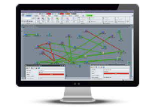
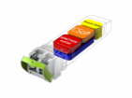
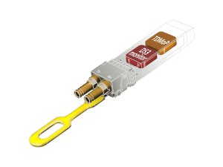
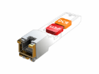
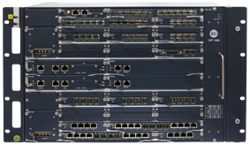
The Next Level - Smart CES SFP
Install it in any Neptune IP Platform
Suitable for Low port fan-out use case
Option for Power and Space Constrained
Interop with Neptune CES Card
End to end Management
E1/E3/STM-1/4/16
STM-1/4
E3
E1
STM-16

Slide 9
The World Has Moved to IP and IP Has Evolved…
YOU CAN TRUST THE IP NETWORK
IP networks can deliver services with low latency, low packet loss and predictable jitter.
QoS designs that will prevent congestions
Bi-directional paths
New Traffic Engineering Techniques
SLA-aware
OAM, Performance Monitoring and Telemetry
Network architecture redundancy/protection
Control of misbehaving traffic using analytics
Scalable and simplified
New forwarding techniques – MPLS / SR
Multi-Layer
Automated
Intelligent
Intelligent control and automation
Programmable Network Infrastructure
Traffic Aware
Resource Aware (Network Slicing)
Intent based
Multi-layer

Slide 10
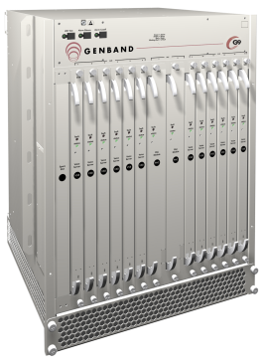
TDM to IP – Use Case
T1 operator
Replacing EoL Network and technology - SDH
CES overlay SRv6
Neptune and Smart SFP solution
Maintaining the Jitter and Latency from the SDH Platform
Jitter Compensation at the Neptune platform
E1
SDH Ring
E1
GE
GE
SRv6
Network
E1
E1
10G
GE
Remote
Terminal
Voice
Switch
Notes:
Jitter from SRv6 network.
Saving on foot print with smart SFP.
More 3 E1s – CES Card is more cost effective.

Slide 11
Added Advantages of a New Transport Platform
Tony / Elea

Slide 12
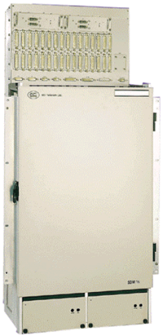
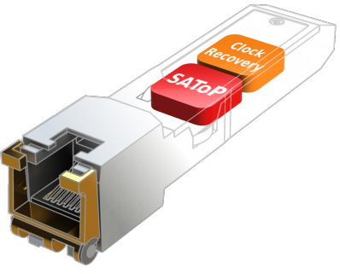
The Incredible Shrinking Element
There are strong space, power and age arguments for replacing old SDH
IP has all of the network capabilities required to replace SDH whilst continuing to meet the needs of users:
Resilience
Latency guarantees
Excellent OAM&P (operations, administration, maintenance and Performance)
More accurate timing
STM-16 ADM
from 2000
Full 300mm rack Consumes 400W
Switches 5Gb/s
and from 2015
1U and 100W
Switches 300Gb/s
CES STM-1 and E1 card
CES STM-4 and E1 SFPs

Slide 13
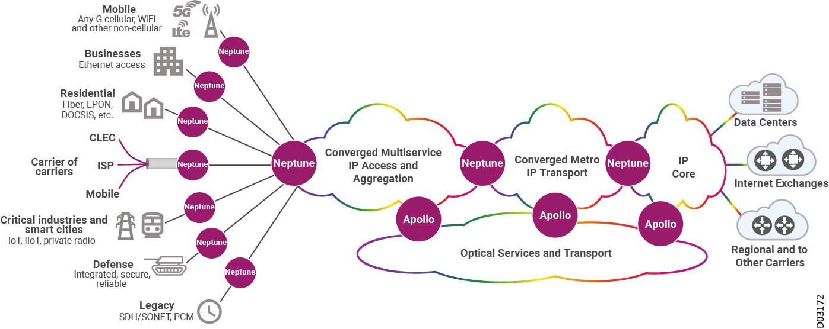
Support For New Services In One Platform
Unified 4G/ 5G Mobile xHaul
Broadband Backhaul
Multi-Access Edge
IP wholesale services
Business services: MEF services, L2 VPNs and L3 VPNs
Business and Mission Critical networking
SDH to IP Migration

Slide 14
Why Operators Are Still Buying SDH Why Could This Create A Longer-term Problem For Them
Tony

Slide 15
Why are some operators still buying new SDH?
To patch or extend an existing network;
To interconnect with other SDH networks;
Because their customers insist on SDH;
Because they understand and trust SDH
SDH/SONET Equipment Spending
US $ (Billion)
BUT
Availability of SDH is coming to an end; and
Shouldn’t new investment be in a technology with a future?
Source: IHS Markit Enterprise Edge Connectivity Strategies, NA Enterprise Survey, 2019

Slide 16
What Are the Migration Options
Elea and Tony

Slide 17
Migration Options
Migration Reality
Convert the TDM services/devices to IP
New IP capable equipment; or
Upgrade existing equipment to IP capable interfaces; or
Emulate TDM services on an IP capable network
Carry TDM services over a G.709 OTN
In most cases, power and space savings are insufficient to overcome the costs and issues:
Engineering resource is needed to plan and implement service changes
Customer service resource is needed to inform customers of service outages
New services are likely to be significantly lower margin than legacy
Customers faced with change can move provider or cease the service
……. but keeping SDH running increases risk of failure

Slide 18
Is Mass Migration the Only Option…..?
Migration costs are high, so don’t add new services to old SDH networks and don’t build more SDH
Build new IP networks with Circuit Emulation capabilities or add Circuit Emulation to your existing IP networks
Leverage proven packet switched network technologies like label switching to deliver SDH services together with IP services.
Migrate sensitive and critical legacy services from SDH to IP irrespective of the cost!
As SDH ages, the likelihood of an unrecoverable failure grows
Apart from the serious risk to life and critical services, not acting now to secure sensitive and critical services risks: reputational damage; fines; litigation; and regulatory penalties.

Slide 19
SDH-to-IP Migration Benefits
Reduce the risks and costs of having a legacy network.
Future proofing your network as services move to all-IP
Automation and Orchestration
Multi-service Platform
Higher Capacity
New traffic engineering schemes
Network support for new services
Optimised use of Network Resources
Hard QoS for predictable performance coupled with statistical multiplexing of Best Effort services.

Slide 20
Summary
David, Elea and Tony

Slide 21
Summary
Stop investing in SDH, withdraw from using SDH:
SDH is EoL and EoM
Skilled people running SDH are retiring
There are significant risks in using out of date technology
Ribbon has the expertise and capabilities to support transformation:
SDH to IP, OTN and WDM
Ribbon has field proven processes for:
Critical Infrastructures
Service Providers
Now is the time to tackle legacy SDH – move to IP and migrate sensitive and critical services as a priority

Slide 22
Questions

